Slide 1
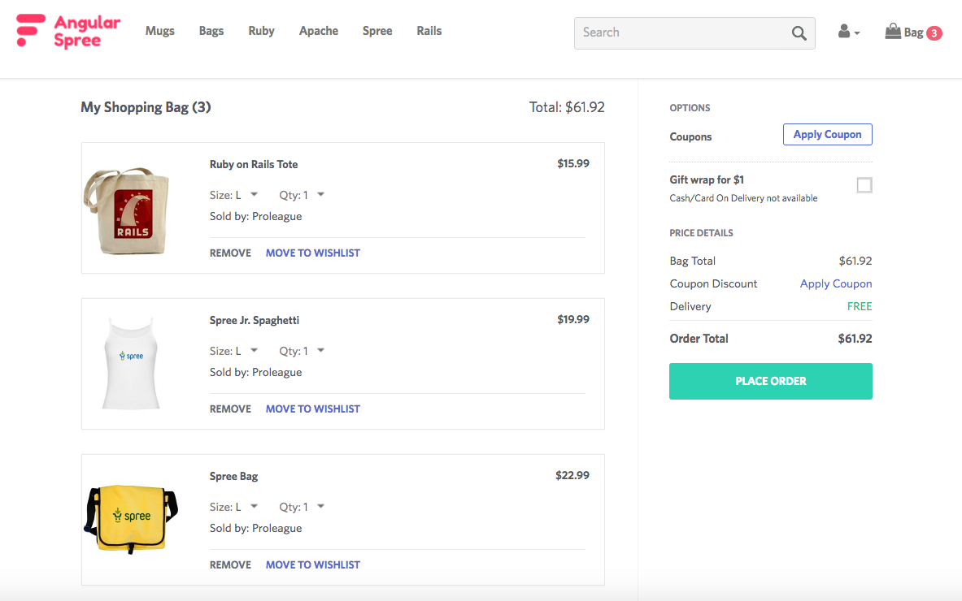

Slide 7
Portions of the screen that exhibit certain behavior are called 'Components' in Angular
One can define as many logical components as he/she wants, there are no rules
Example components in a ecommerce application would be cart, navigation, products details, product list etc.

Slide 8
A component in Angular version 6 using CLI is created by running the command ng generate component <component name>
A component folder created will typically include an HTML file (Template), a css file, a typescript file for the component business logic, and a user can create another typescript file for a Service in that folder
Template displays the data passed on by corresponding component file
A component file receives or sends data to a service, and processes the data received from service before forwarding it to a template. The process is called data binding.
A service handles the logic that is not related to the UI such as backend interaction
HTML template (e.g. cart.html)
A component file (e.g. cart.component.ts)
A service file (e.g. cart.service.ts)
CSS file (e.g. cart.css)

Slide 9
Other important concepts in Angular

